Slide 1
Back of House Display Graphics
Responsible Gaming Education Week | September 13-19, 2020

Slide 2
How To Use
Add these slides to your back of house screens leading up to and during Responsible Education Week.
Download the image files here (zip file).

Slide 3


Slide 4


Slide 5
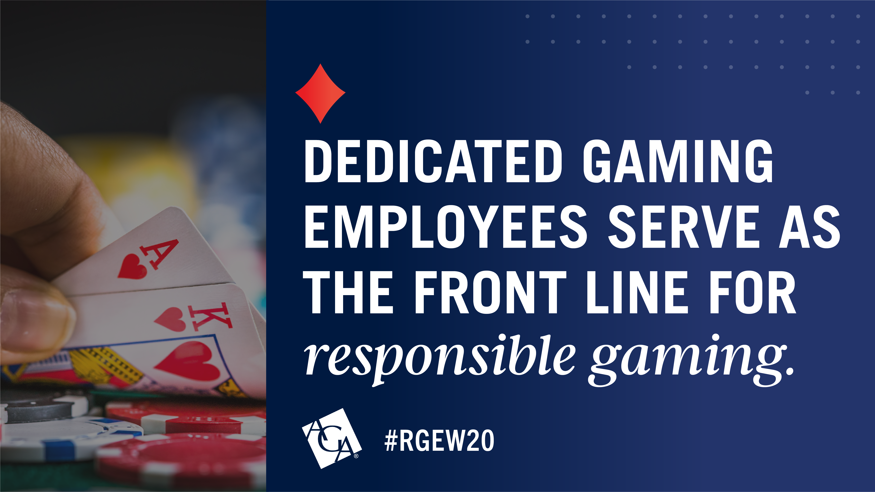

Slide 6


Slide 7


Slide 8


